Slide 1

GCEK ERP SYSTEM
GOVERNMENT COLLEGE OF ENGINEERING,KALAHANDI
SUPERVISED BY:
DR. GOPAL BEHERA
HOD,ASSITANT PROFESSOR
PRESENTED BY:
YUBARAJ MOHANTY
REGD NO. : 2201110076
ASHAKIRAN SAMANTARAY
REGD NO. : 2201110014

Slide 2
TABLE CONTENTS
INTRODUCTION
2. MOTIVATION
3. OBJECTIVES
4. DATA FLOW DIAGRAM
5. INTERFACE OF ERP SYSTEM
6

Slide 3
MOTIVATION
Manual record-keeping is time-consuming.
Lack of centralized data access.
Communication gap between departments.
Need for transparency and automation.

Slide 4
OBJECTIVES
Develop a web-based ERP platform for GCEK
Integrate modules for students, faculty, and admin
Simplify daily operations and data management
Ensure secure data access and user authentication

Slide 5
SYSTEM WORKFLOW

Slide 6
DATA FLOW DIAGRAM

Slide 7
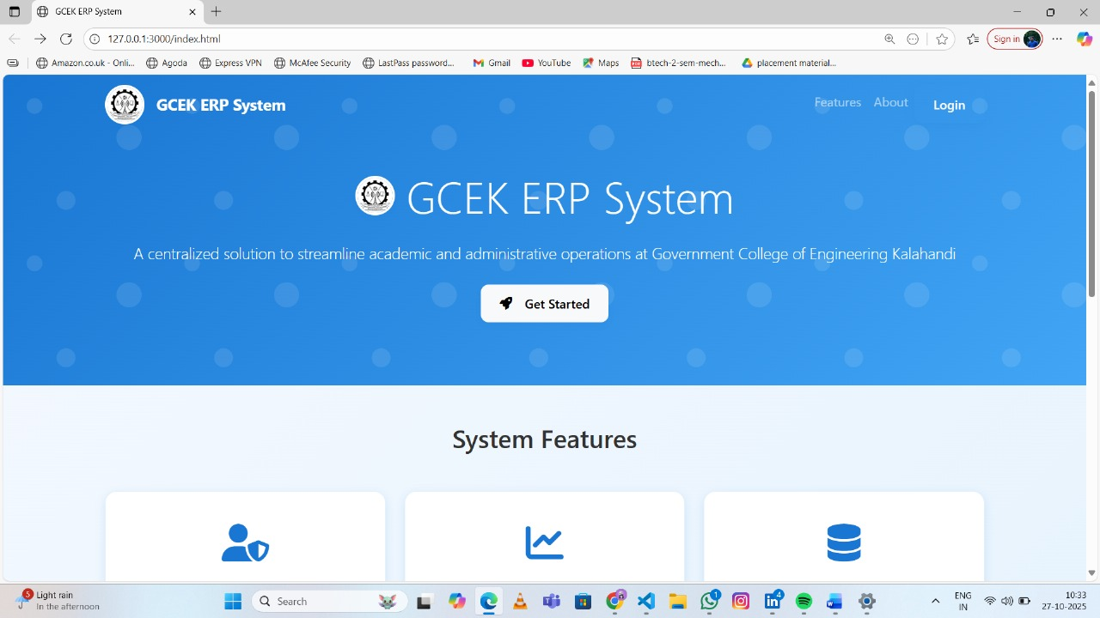
GCEK ERP SYSTEM

Slide 8
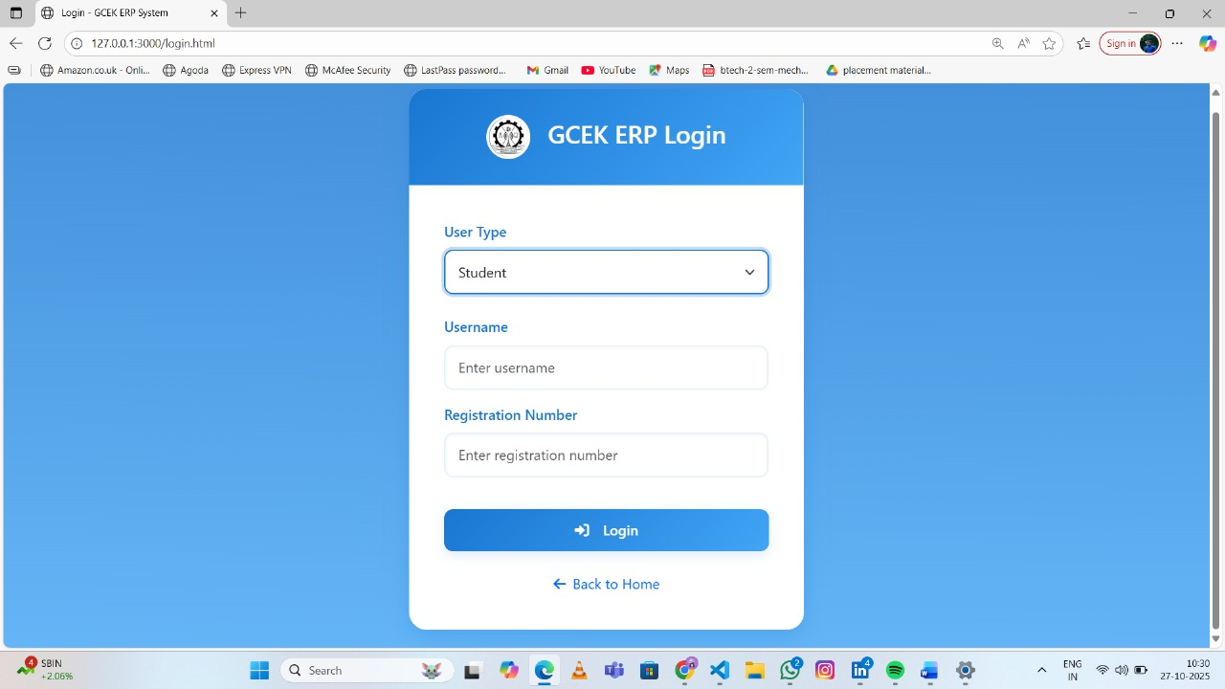
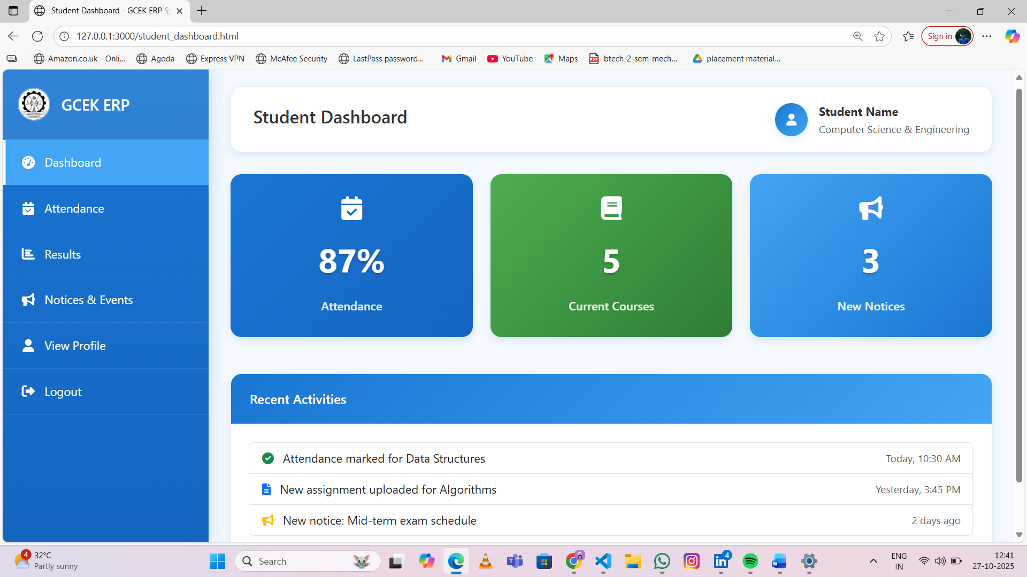
STUDENT MODULE

Slide 9
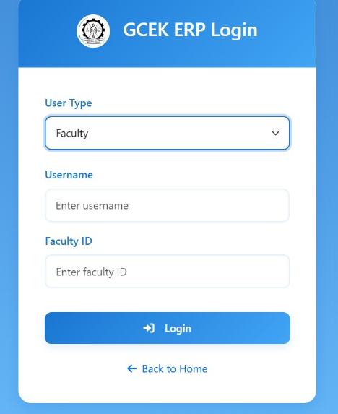
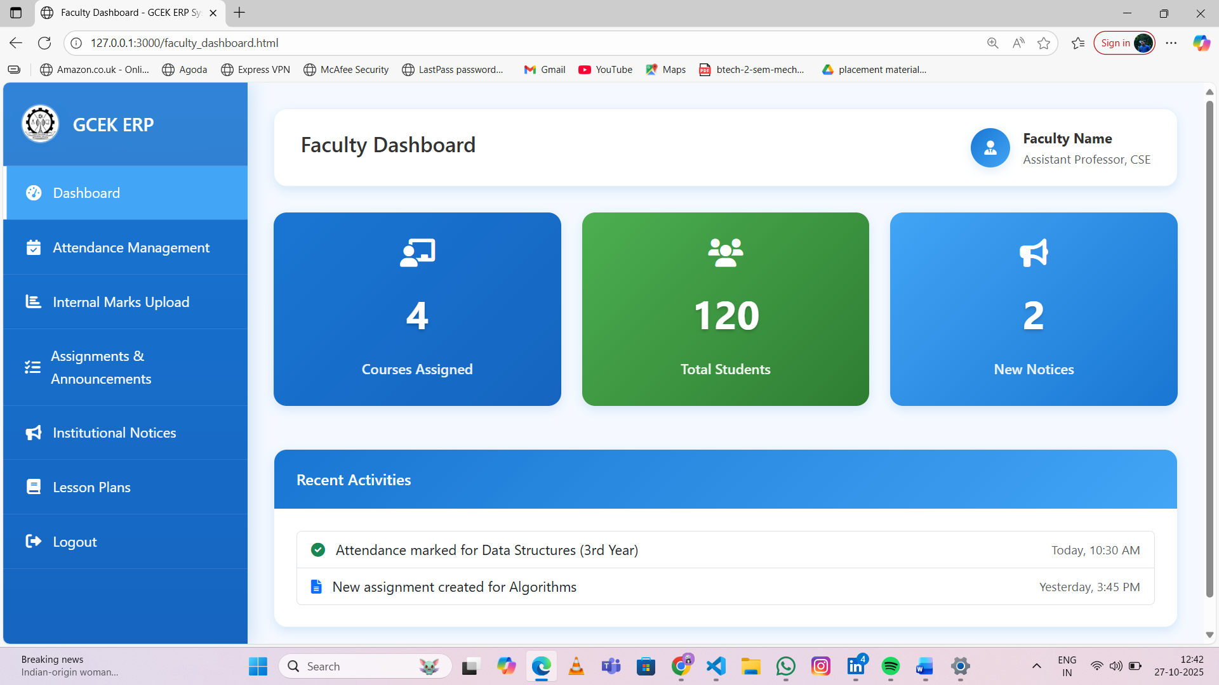
FACULTY MODULE

Slide 10
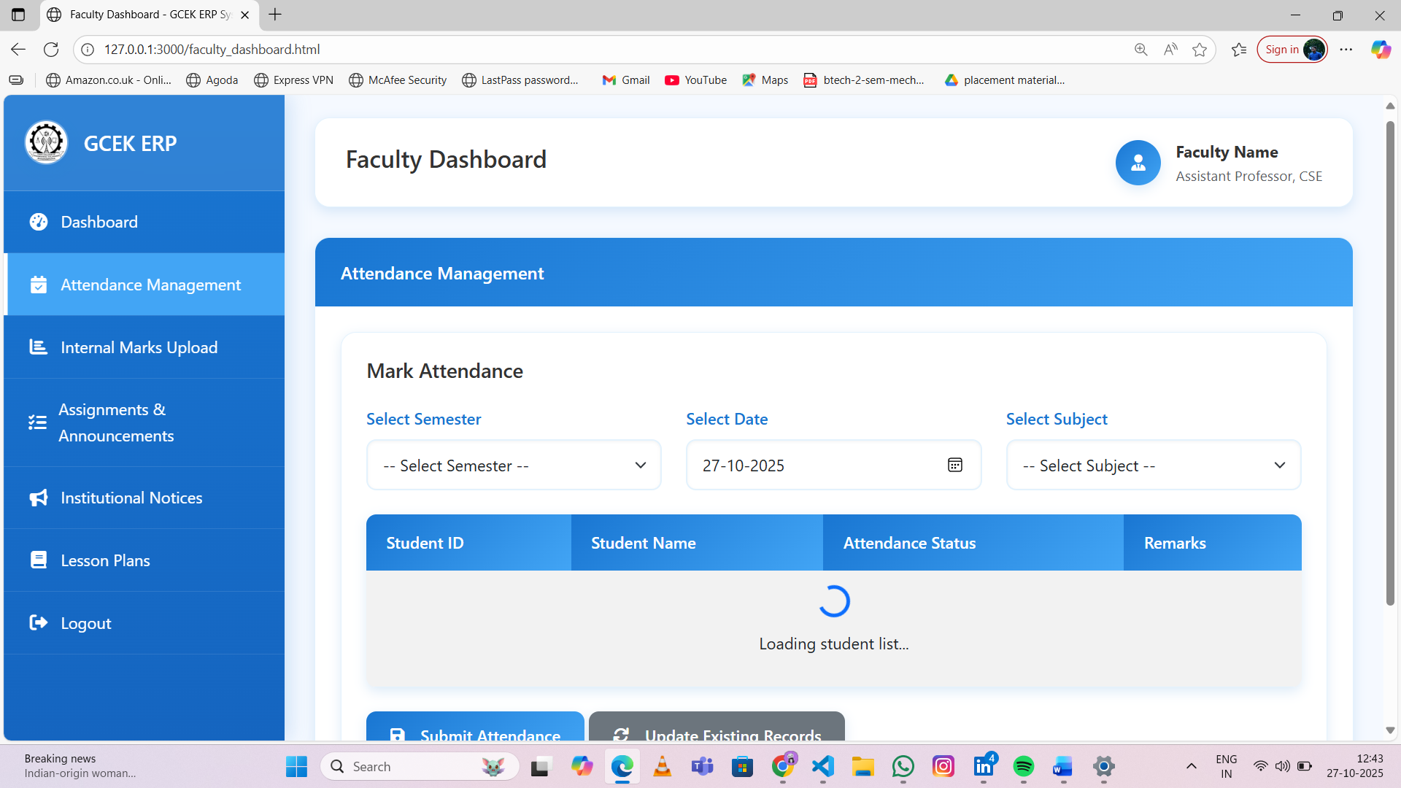
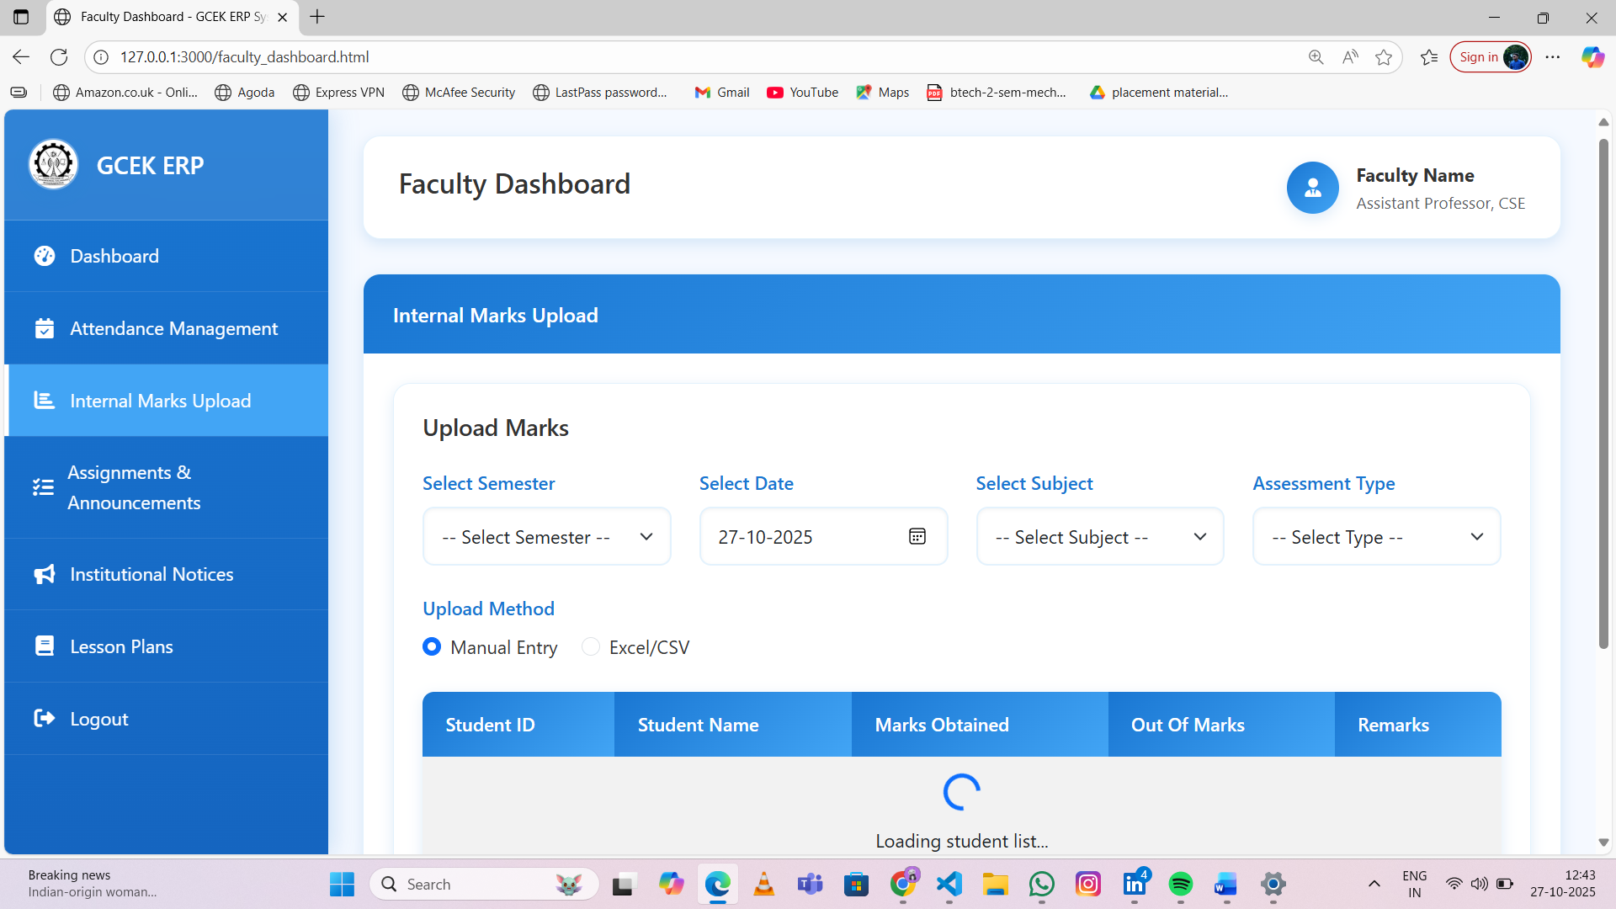

Slide 11
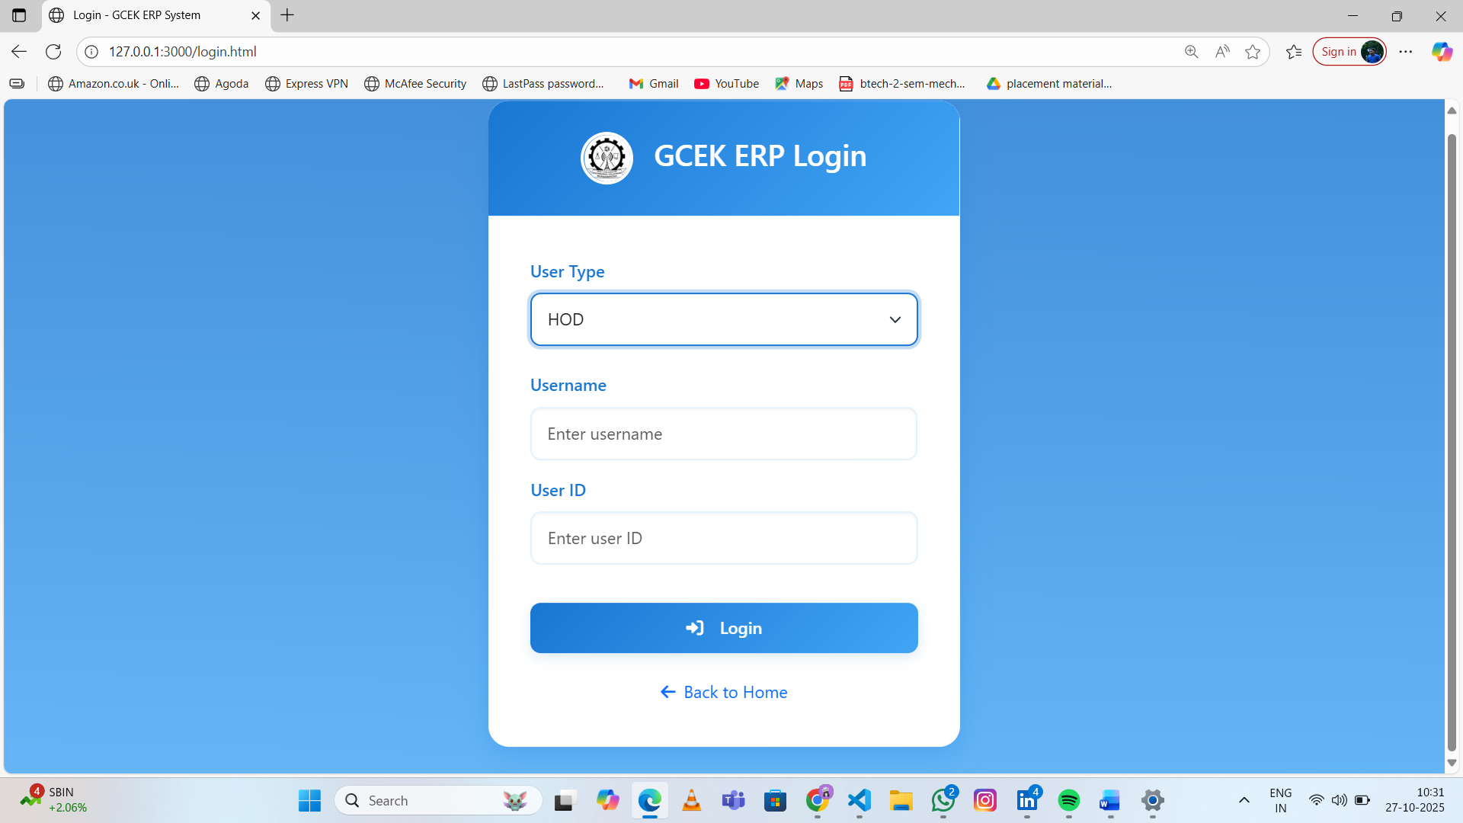
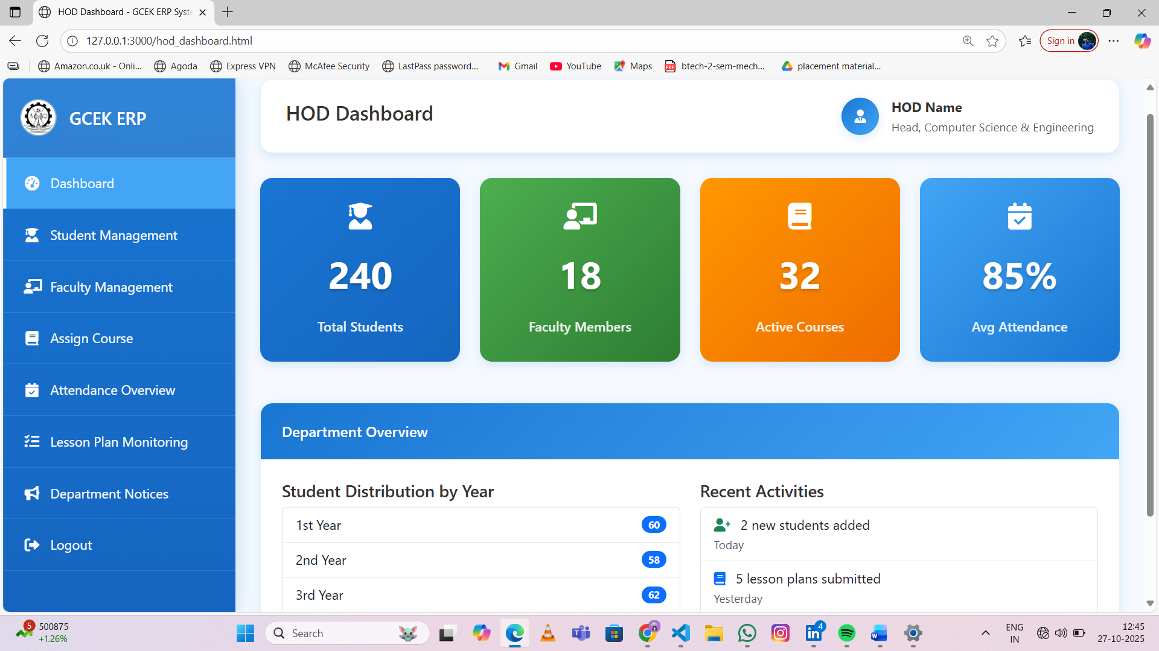
HOD MODULE

Slide 12
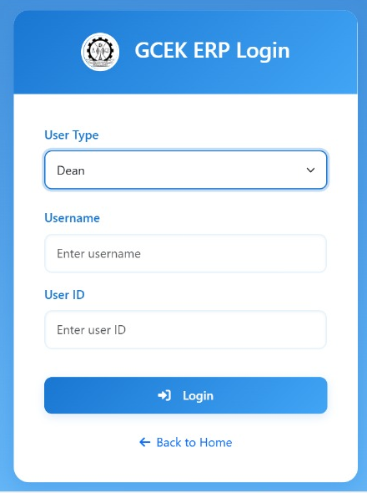
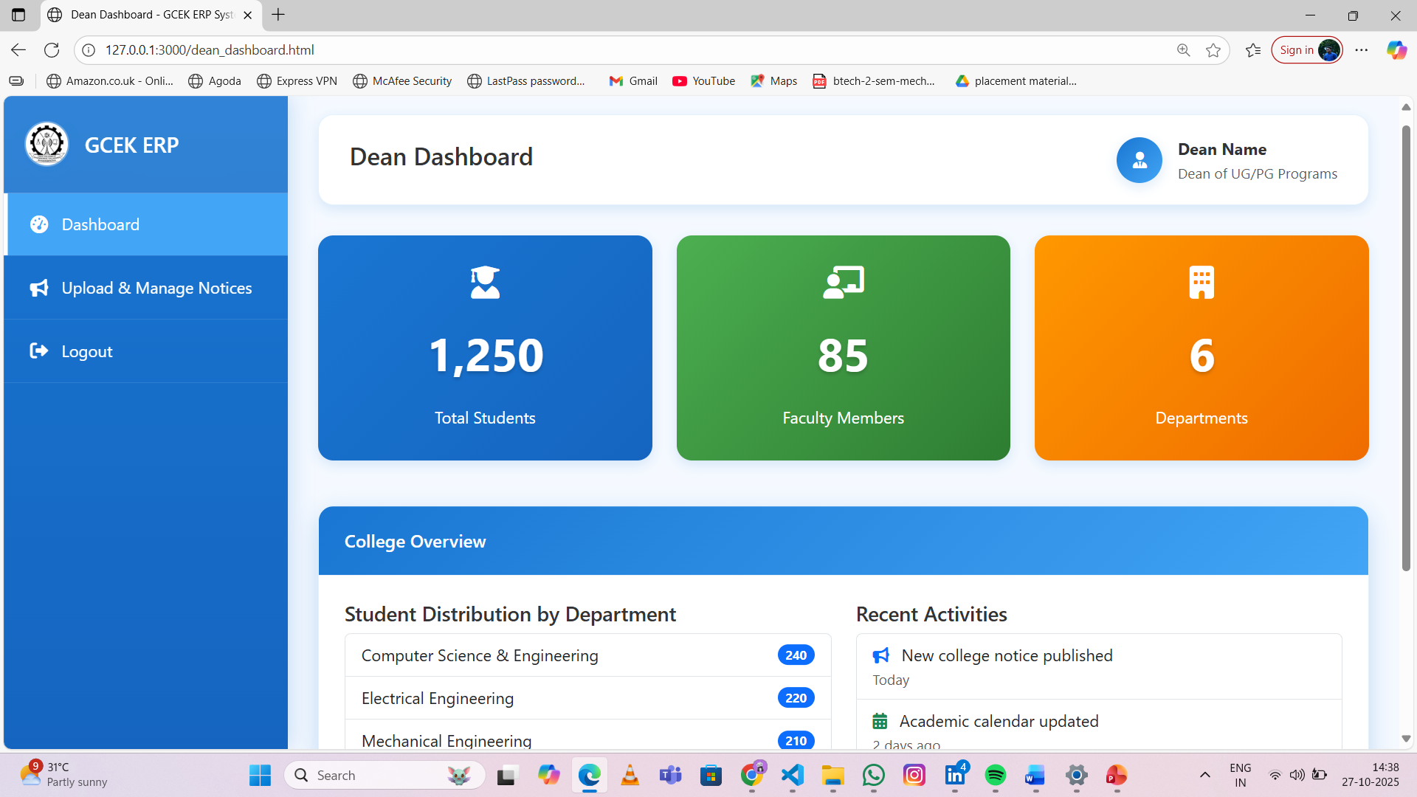
DEAN MODULE

Slide 13
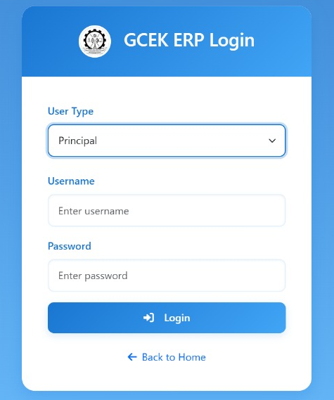
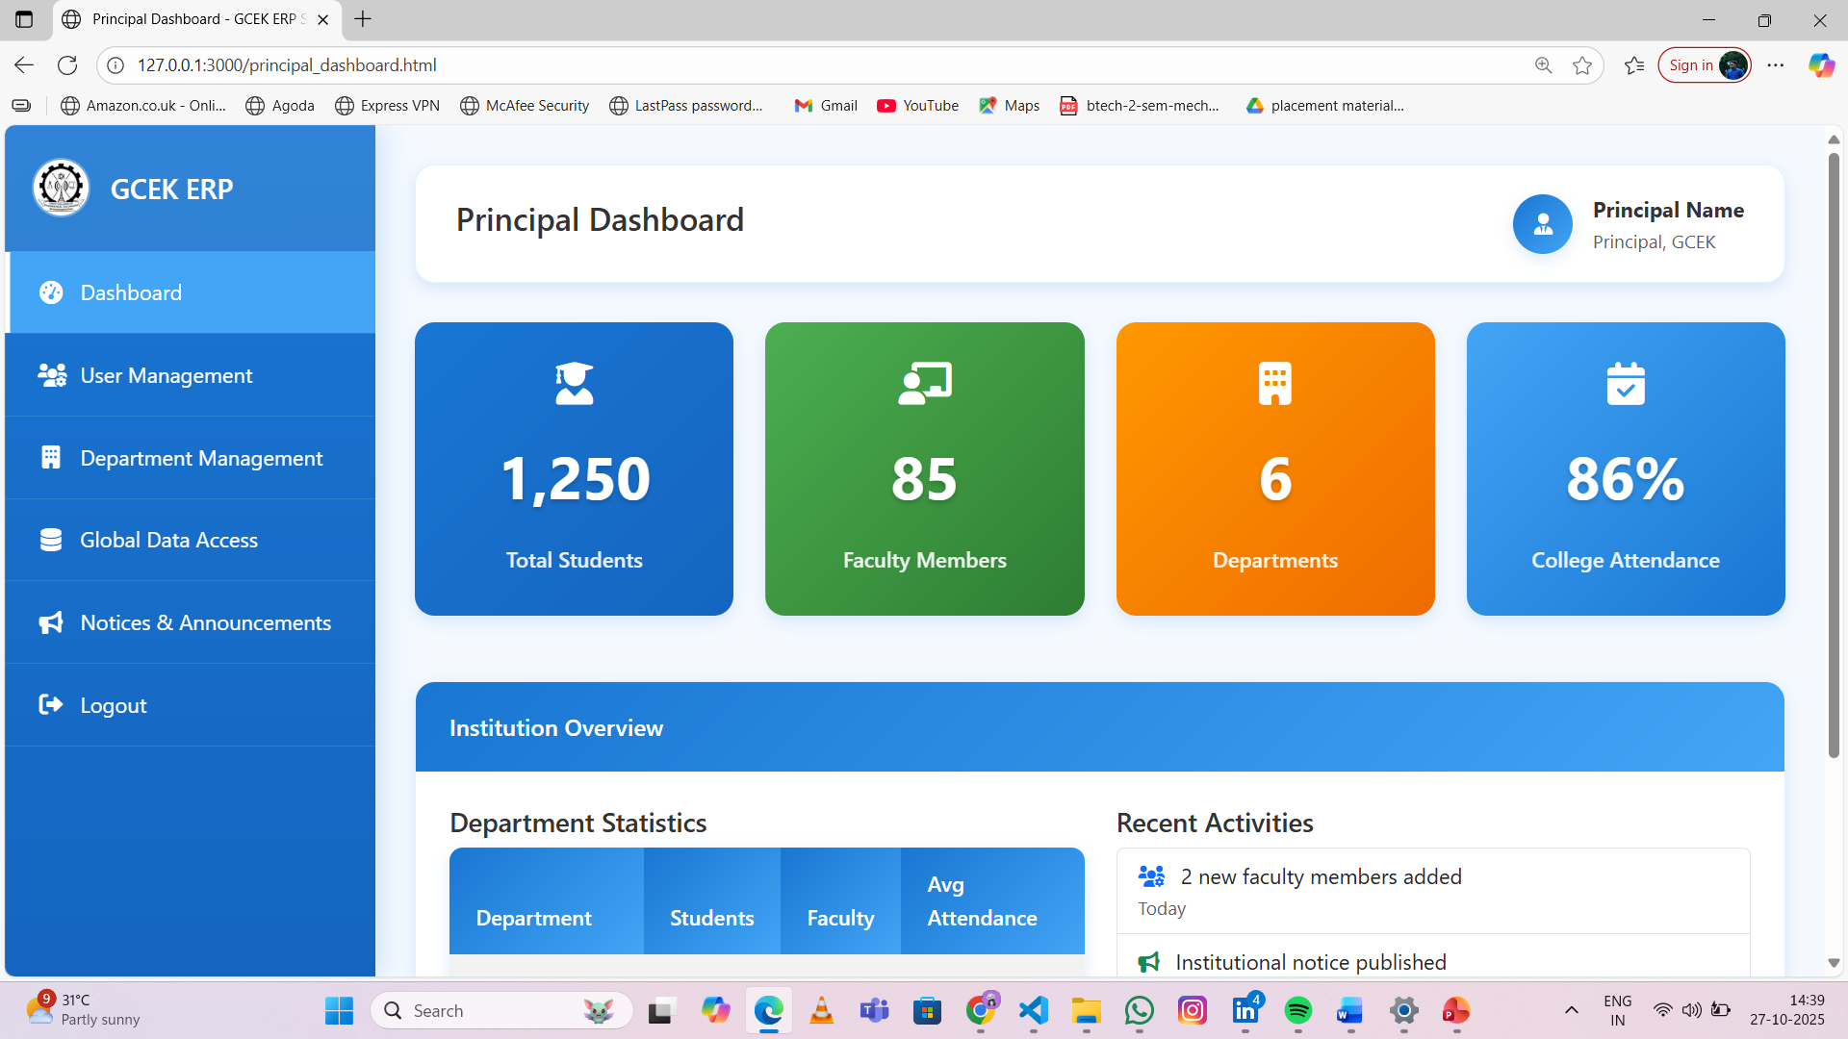
PRINCIPAL MODULE

Slide 14
ADVANTAGES
Centralized data management.
Reduced workload and human error.
Easy access for students and staff.
Secure and scalable design.

Slide 15
LIMITATION
Initial setup and training required.
Internet dependency.
Future maintenance cost.

Slide 16

THANK YOU

